Slide 1
Machine Learning Methods in Mechanics
Prateek Patankar (3509498)

Slide 2
Introduction
The concept is to build a physics informed neural network to provide a solution the classical Lid Driven Cavity Problem in Fluid Mechanics.
Based on the work of Raissi et. al. (2017).
Solution for a well posed 2D steady state Navier Stokes Equations.
Loss function incorporates the whole Boundary Value Problem in the form of residual loss and boundary loss.
No flow data needed.
Loss calculation involves the calculation of the derivatives of the outputs.
Custom layer calculates derivates by automatic differentiation, utilizing the derivaives generated for back propagation.
Different optimizer used

Slide 3
Problem Definition

Slide 4
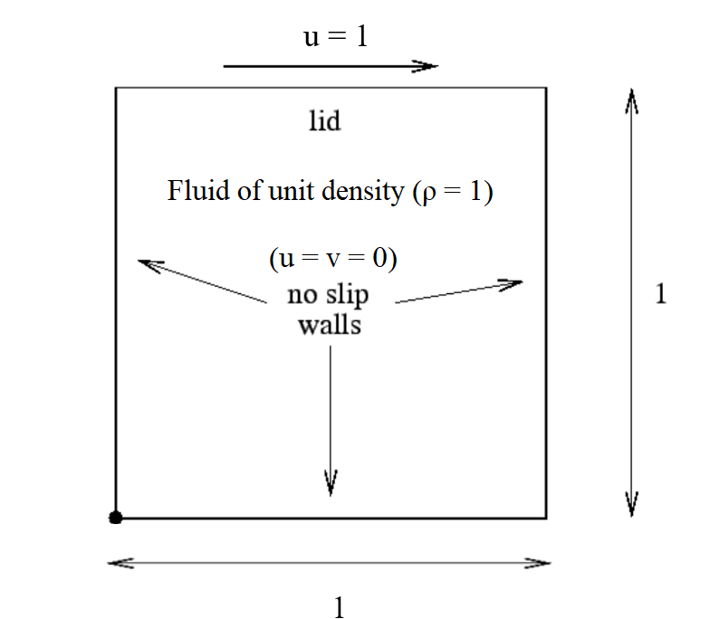
Problem Definition
Problem an example of an incompressible flow in a confined volume which is driven by the tangential motion of a bounding wall.
Popular problem serving as a benchmark for testing fundamental aspects of solution methodologies.
The diagram illustrates the domain, and the boundary conditions.
Bi-unit square domain.
Essential boundary conditions at the walls and the lid.
No slip boundary condition the walls i.e., u = v = 0
Tangential unit velocity on the lid i.e., u = 1
Incompressible fluid of unit density.
The fluid has a finite kinematic viscosity value ‘ν’
Different values of Reynold’s number achieved by changing the ν value.

Slide 5

Problem Definition
The BVP would be summarized as:
For Approximating a solution for u(x, y), v(x, y), p(x, y): D → R
$$\frac{δu}{δx}+ \frac{δv}{δy}=0$$
$$u.\frac{δu}{δx}+ v.\frac{δu}{δy} +\frac{1}{ ρ}.\frac{δp}{δx}− ν.\left( \frac{δ^{2}u}{δx^{2}}+ \frac{δ^{2}u}{δy^{2}}\right)=0 x, y ∈\left[0,1\right]$$
$$u.\frac{δv}{δx}+ v.\frac{δv}{δy} + \frac{1}{ ρ}.\frac{δp}{δy}− ν.( \frac{δ^{2}v}{δx^{2}}+ \frac{δ^{2}v}{δy^{2}}) =0$$
Subject to:
$$u \left(x,0\right)=v\left(x,0\right)=0 for x ∈[0,1]$$
$$u \left(0,y\right)=v\left(0,y\right)=0 for y ∈[0,1)$$
$$u \left(1,y\right)=v\left(1,y\right)=0 for y ∈[0,1)$$
$$u\left(x,1\right)=1, v\left(x,1\right)=0 for x ∈[0,1]$$

Slide 6

Problem Definition
For incompressible flow, if we define the velocities with respect to stream function $Ψ$ as follows:
$$u= \frac{δΨ}{δx}, v= −\frac{δΨ}{δy}$$
This interpretation a priori satisfies the incompressibility condition.
It also allows us to have 1 fewer output.

Slide 7
Network Architecture

Slide 8
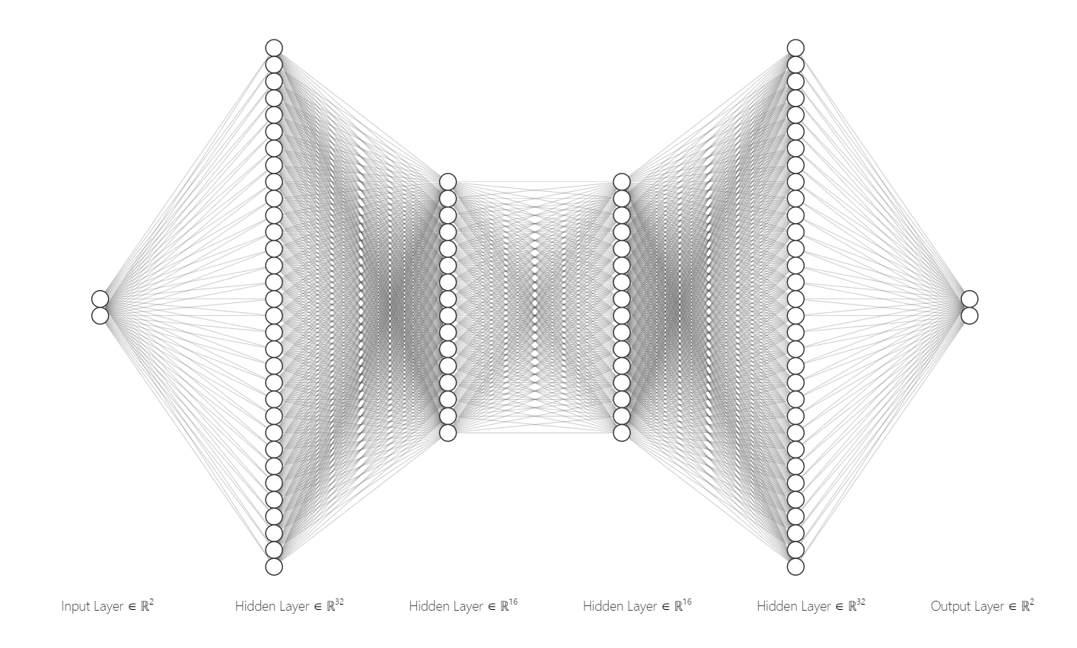
Ψ(x,y)
Custom Layer for Gradient Calculation for Loss Function
x
y
p(x,y)

Slide 9
Network Architecture
The following configuration of 4 hidden layers is utilized.
(32, 16, 16, 32)
Recent literature indicates that shallow but wide networks provide a better performance.
Less layers possibly would lead to less noisy gradients.
This trend was not observed in this case
The above-mentioned structure provided reasonable optimum between computation time and accuracy.

Slide 10

Network Architecture
Differentiability of the activation function with respect to the inputs is important in calculating the gradients.
Many otherwise popular activations have a vanishing gradients. Activations such as ‘swish’ or ‘mish’ functions which are as follows:
$$swish\left(x\right)=x.sigmoid\left(x\right)= \frac{x}{1+ e^{−βx}} with β=1$$
$$mish\left(x\right)=tanh(softplus\left(x\right))= tanh(log \left(e^{x}+1\right))$$
are more suitable choices.
Swish seemed to provide better results than mish.

Slide 11

Network Architecture
The loss function incorporates loss from adhering to the governing equation in the interior, termed as ‘Residual Loss’, and adhering to the boundary conditions on the boundaries.
The residuals are as follows:
$$residual in x ⇒ u∗u_x + v∗u_y + p_x/self.rho − self.nu∗(u_xx + u_yy)$$
$$residual in y⇒ u∗v_x + v∗v_y + p_y/self.rho − self.nu∗(v_xx + v_yy)$$
All the derivatives (u_x, u_y, u_xx etc.) will be calculated in a custom layer, by automatic differentiation from the backpropagation process of the constructed network.

Slide 12
Training

Slide 13
Training
Training input:
Points in the domain.
Popular literature states that it is suitable to have equal number of points for the interior of the domain, and the boundary.
It was observed that about 15000 training points on both the interior and the boundary, needed to be provided.
Randomized point selection for training.
Training Output:
The boundary conditions are enforced in terms of velocity, but the network output is in terms of the stream function.
Training output modified to the correct dimensions to account for the same.
It is null tensors, for the interior and boundary loss, except for the points on the lid, where the x velocity is set to unity.
Test Data:
A cartesian grid, like a discretized grid in traditional numerical methods.
This was done to have data comparable to the numerical solution.

Slide 14
Training
The training was initially done using the standard Adam optimizer with fixed learning rate of 1e-3. However, as pointed out by Raissi, quasi Newton methods, which use an approximation of the Hessian matrix to compute the gradient updates, are much better suited as convergent optimizers for PINNs.
As such, a L-BFGS (Limited-memory Broyden–Fletcher–Goldfarb–Shanno) type convergent optimizer, with a logcosh type activation was utilized, and provided better results.
Further work can be done to fine tune the optimizer in order to achieve better results.

Slide 15
Results

Slide 16
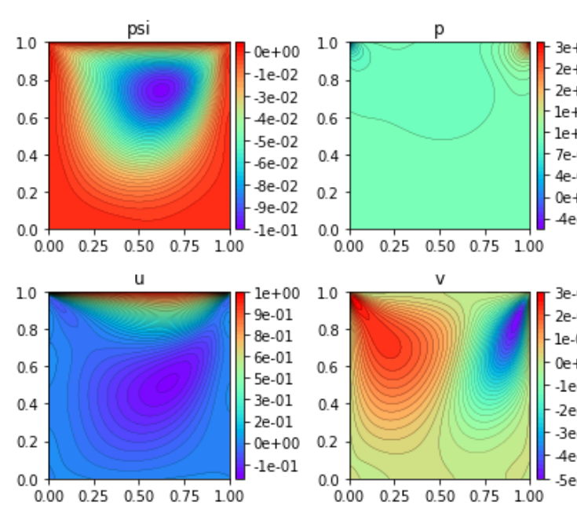
Shows the outputs of the network [Ψ (x,y), p (x,y)]
u, v are calculated from Ψ

Slide 17
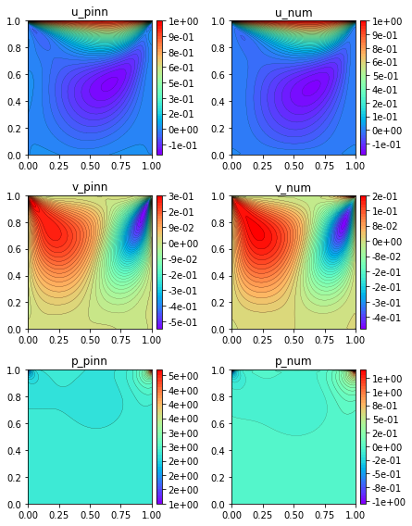
Reynold’s number : 100
Comparison with numerical solution obtained by a finite volume approach.
FVM discretization same as the density of the test output. (100 x 100)
Good approximation of the flow velocity.
High Error in Pressure Prediction
Consistent with Raissi et. al. results

Slide 18
Conclusion
Shows good approximation of the flow in the cavity at low Reynold’s numbers.
To extend the effectiveness of the network to higher Reynold’s numbers, as well as unsteady state transient results, further work needs to be done. Some important areas would be:
Strategic sampling of training data
Modification of the optimization process
To do an ensemble of multiple networks, with each having its own activation function, and then aggregate their predictions.
By using CNN style residual connections, to better facilitate the flow of gradients.

Slide 19
Thank you

